Slide 1
Twitter and Stocks
Rohan Ganguli, David Li, Rachel Park, William Rothman, Ivy Sim
Mentored by Austin Nicola Ardisaputra

Slide 2
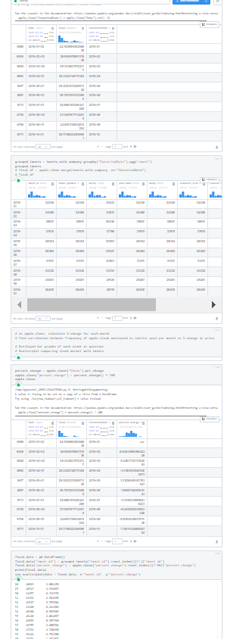
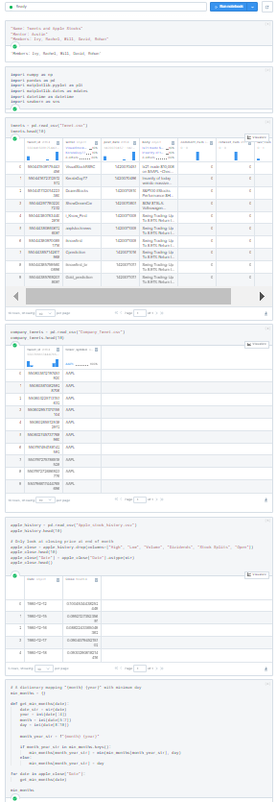
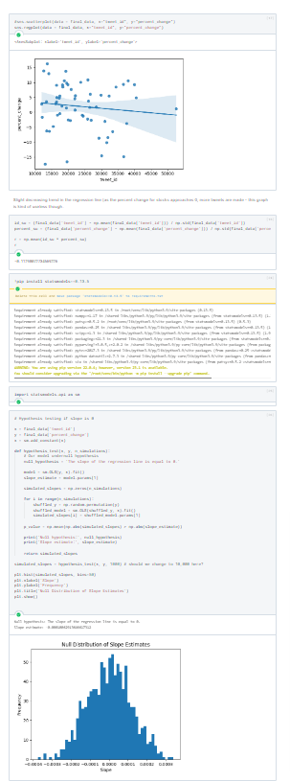

Slide 3
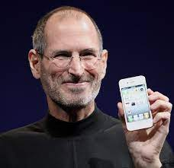

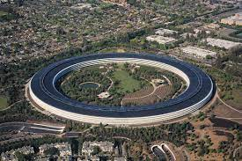
Background I
Why Apple?

Slide 4
Background I
Why Apple?
Apple products are integral to our way of life
FAANG! All of us here love technology
Also, Apple is a good case study

Slide 5



Background II
Why Twitter?

Slide 6
Background II
Why Twitter?
Primary source of public communication of large companies and public officials
Like Apple, everyone uses it
Most publicly available dataset with stock tickers

Slide 7
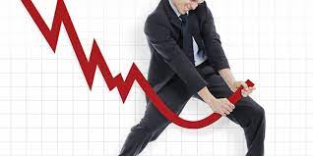

Our Hypothesis
Null: A company’s tweet frequency does not affect their stock price.

Slide 8
Our Hypothesis
Null: A company’s tweet mention frequency does not affect their stock price.
Alternative: A company’s tweet mention frequency affects their stock price.

Slide 9
Methodology
Data Collection: Twitter, Apple stock…
Data Cleaning & Preprocessing: Standardization
Data Analysis
Data visualization: Matplotlib, Seaborn, Plotly
Hypothesis testing

Slide 10
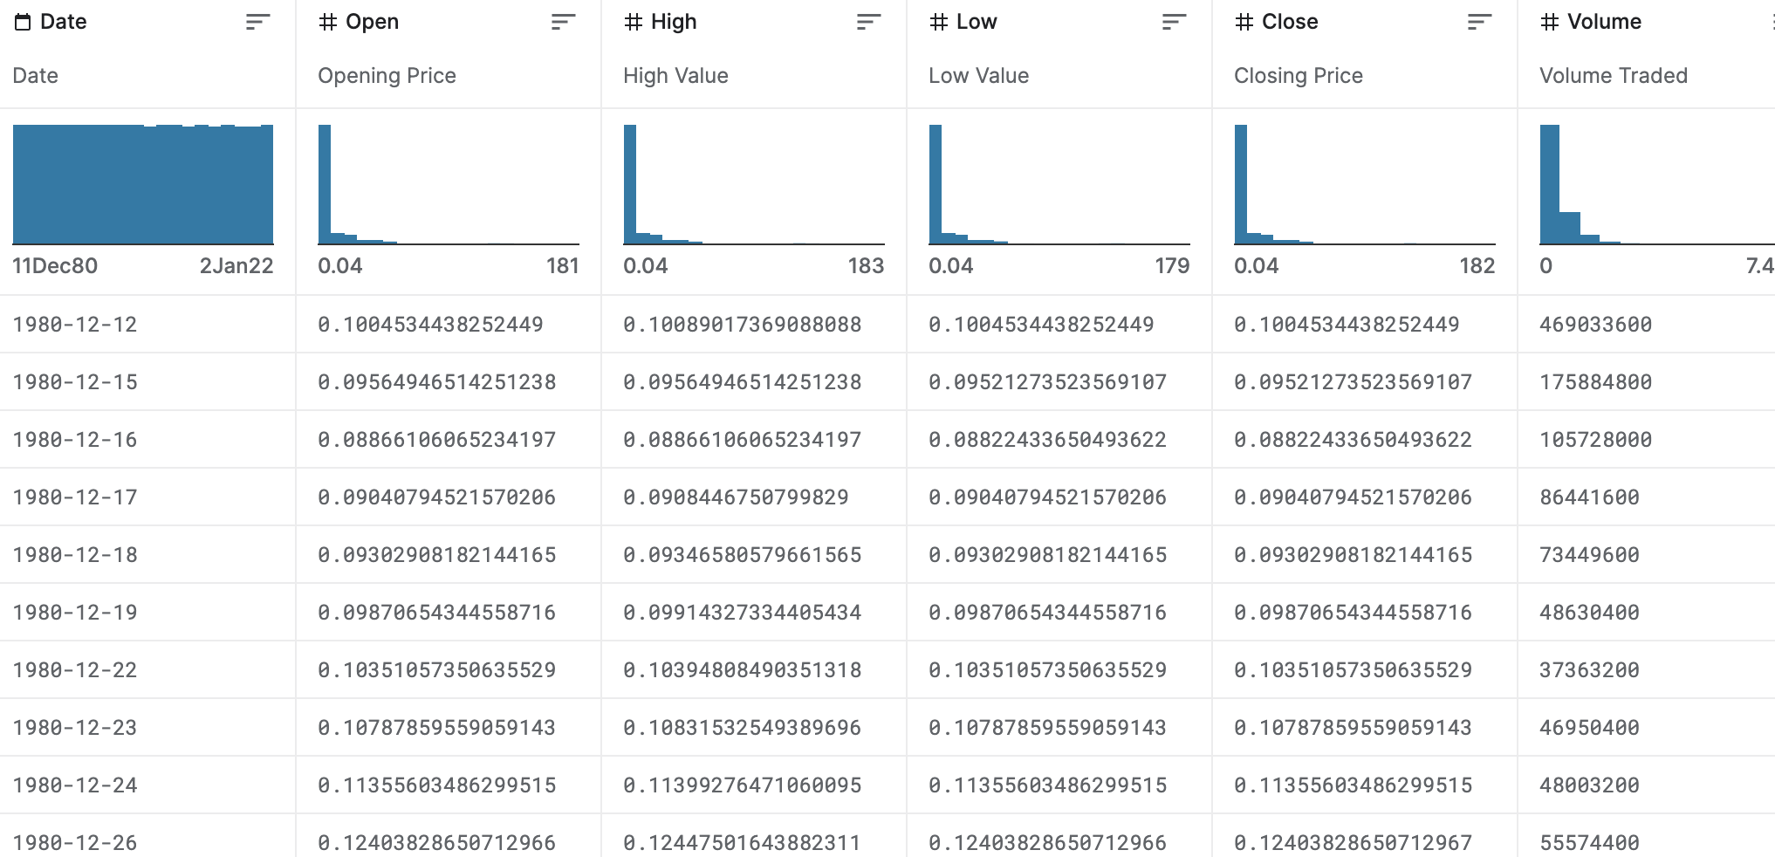
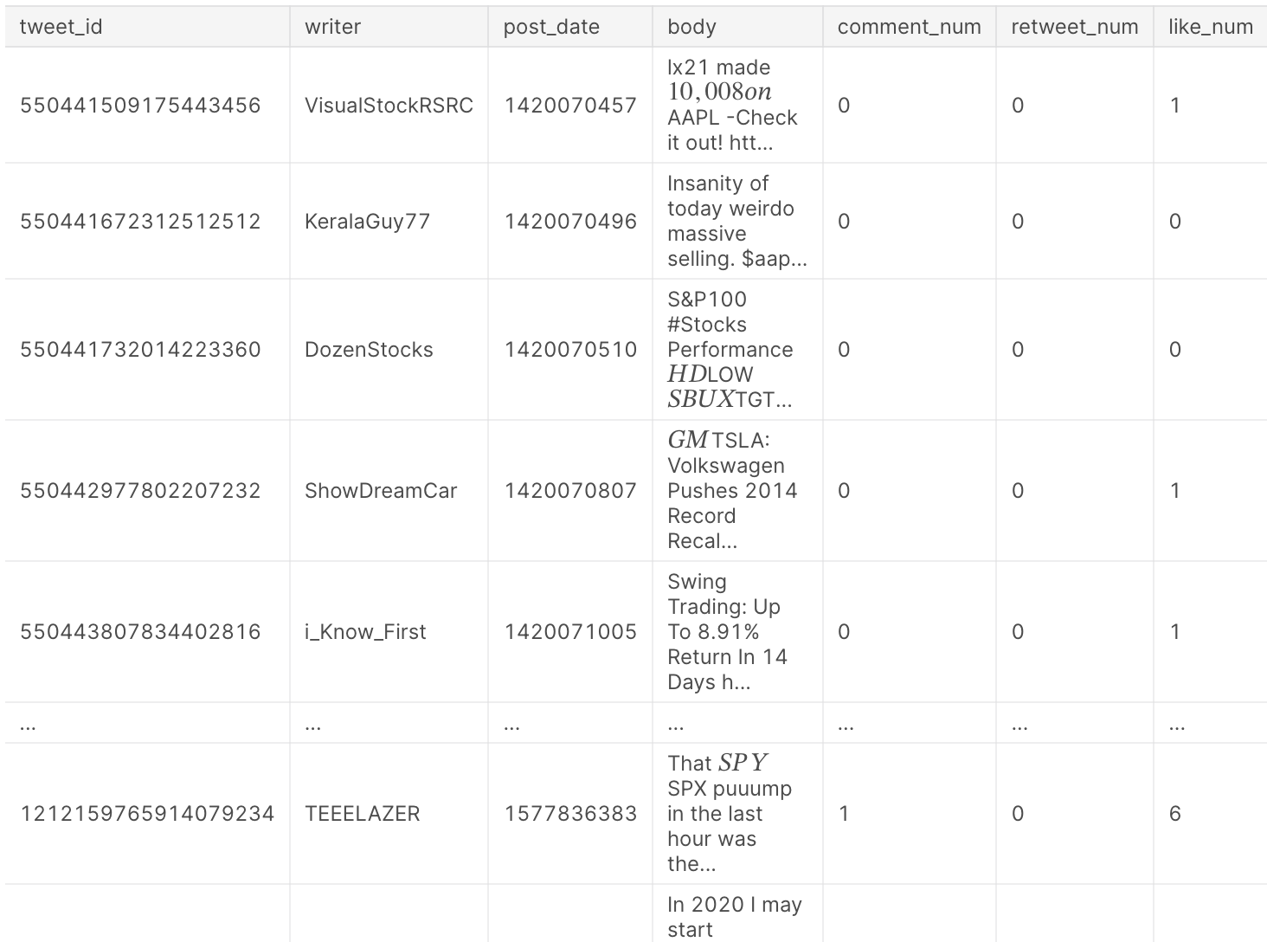
Our Datasets
Apple Stock Data
Shows the stock history of Apple, showing the opening price (according to each date), in addition to the high, low, and closing prices. Also has some additional information, such as volume traded.
Tweets
Shows data about the tweets that were posted, including post date, number of comments, retweets, likes, etc..

Slide 11
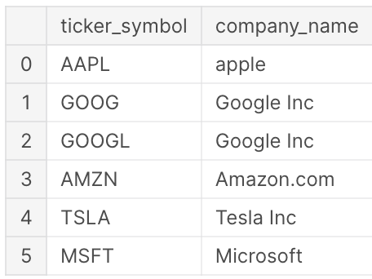
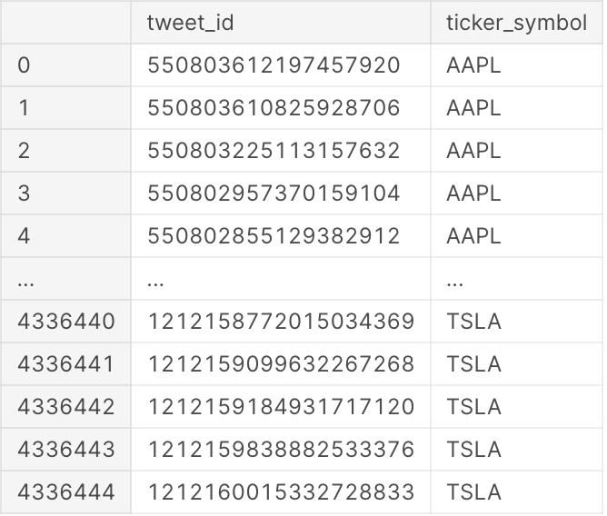
Our Datasets
Company
Shows data associating the company ticker symbol with the company name. Total of 6 different ticker symbols.
Company_Tweets
Shows data with a tweet id along with the corresponding ticker symbol.

Slide 12
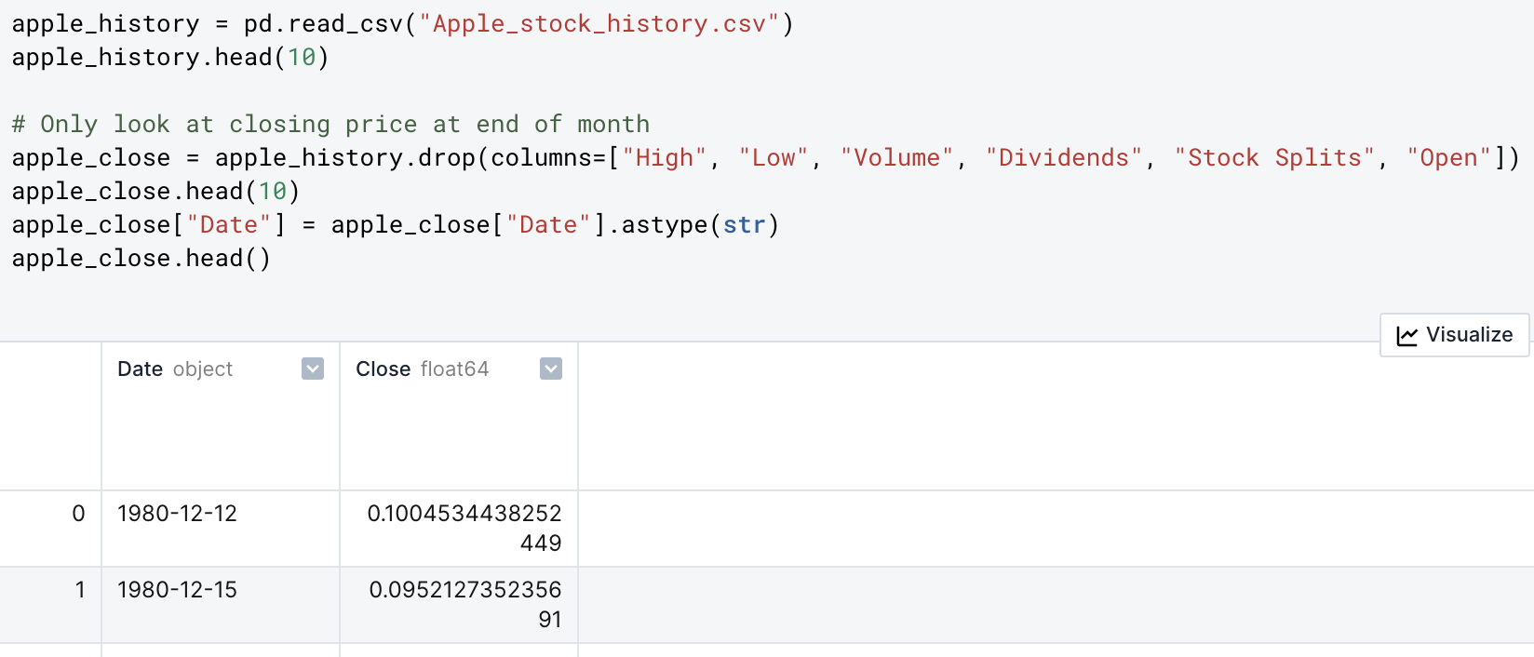
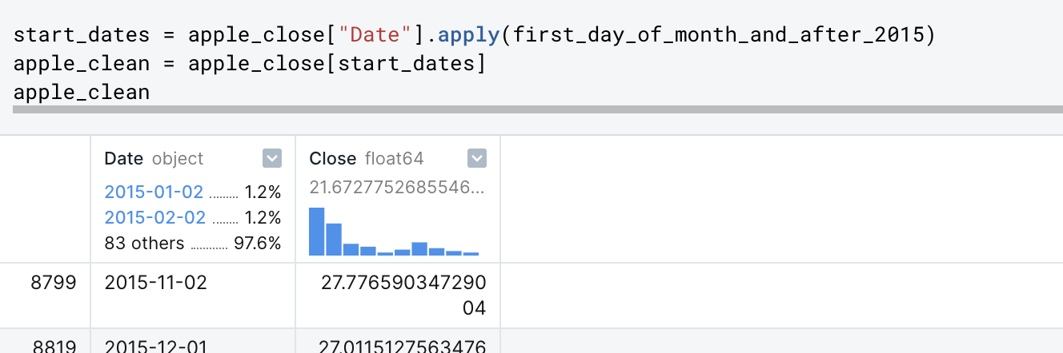
Data Science Cycle
Dropped a lot of unnecessary columns within each dataset
Cleaned the data to only consist of years after 2015.

Slide 13
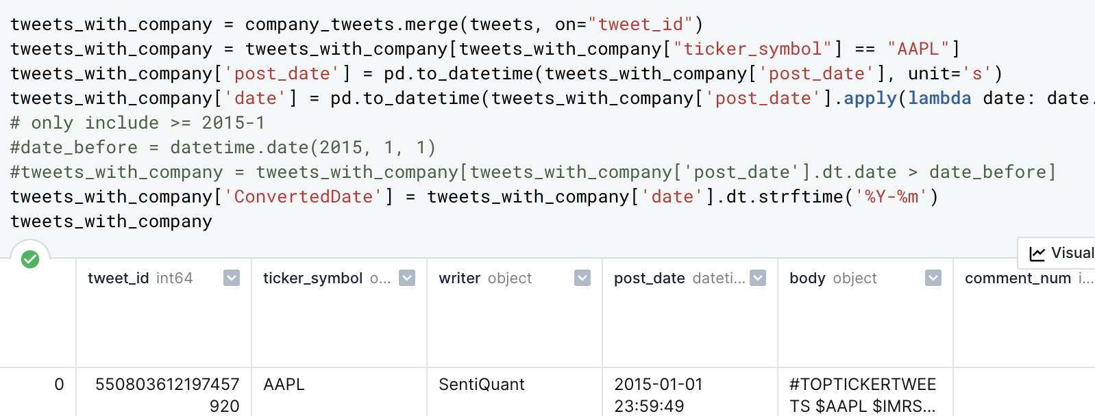
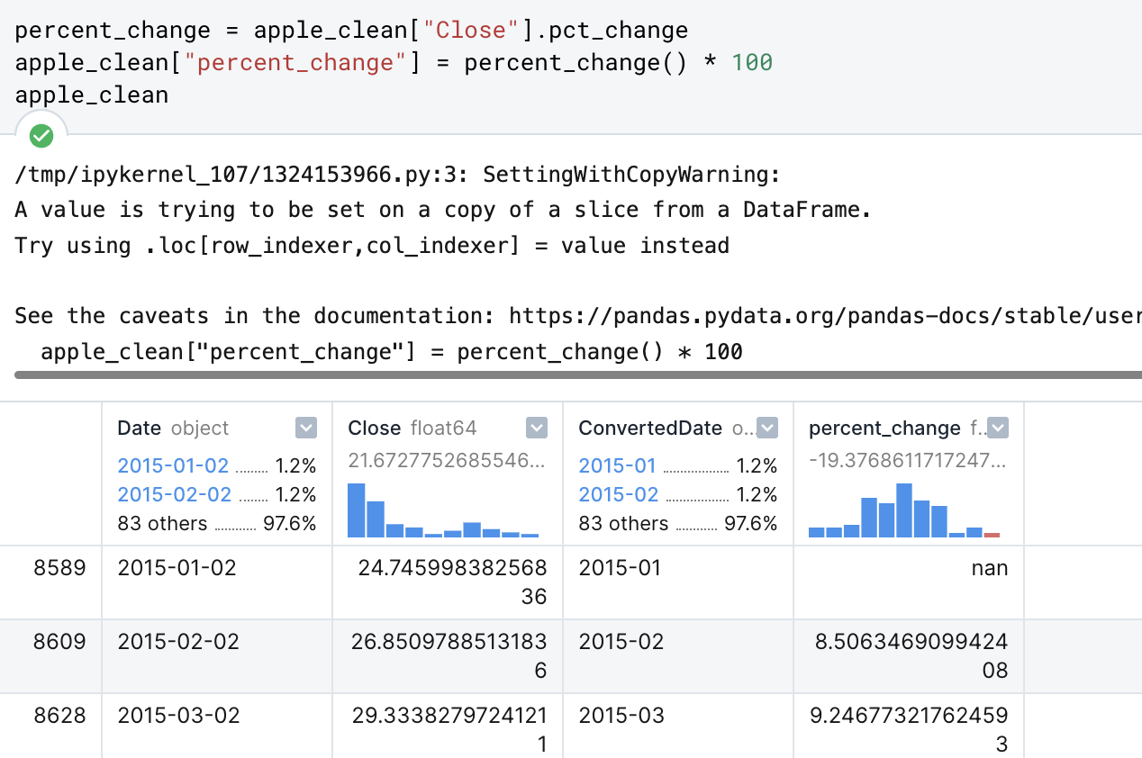
Data Science Cycle
Merged datasets together
Calculated the data we need: percent change in stock price

Slide 14
Visualization
We used scatter plots to visualize the numerical relationship between the number of tweets and the corresponding monthly stock price change.
Using line graphs or bar graphs could not accurately portray the high of variation data points.

Slide 15
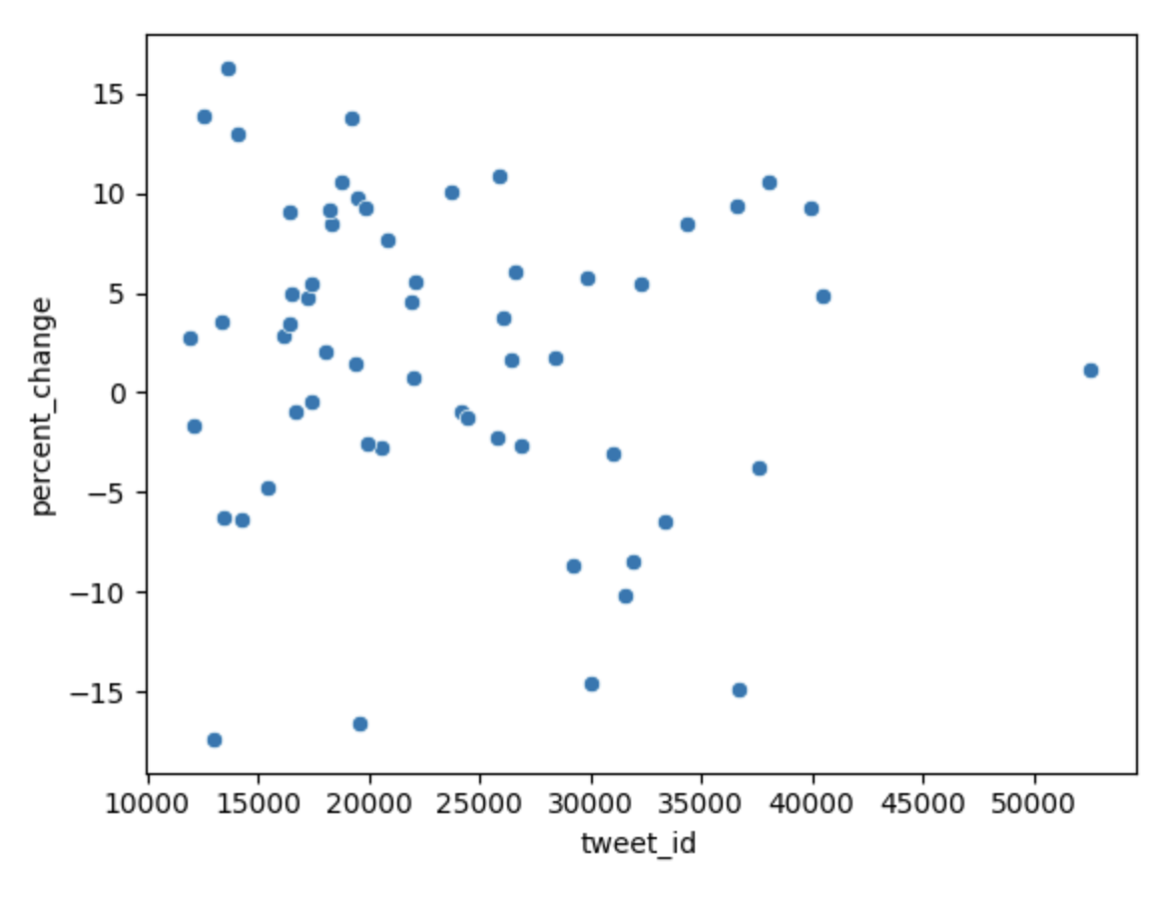
# of Tweets vs. Percent Change

Slide 16
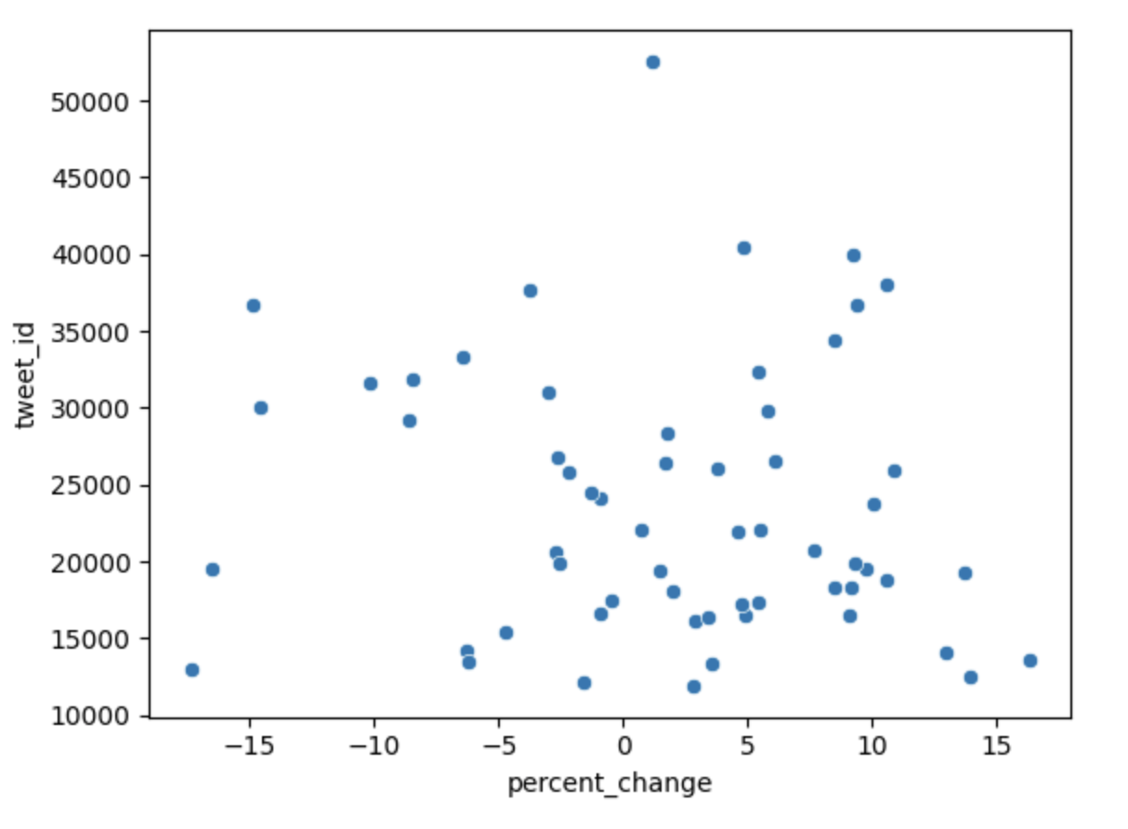
Percent Change vs. # of Tweets

Slide 17
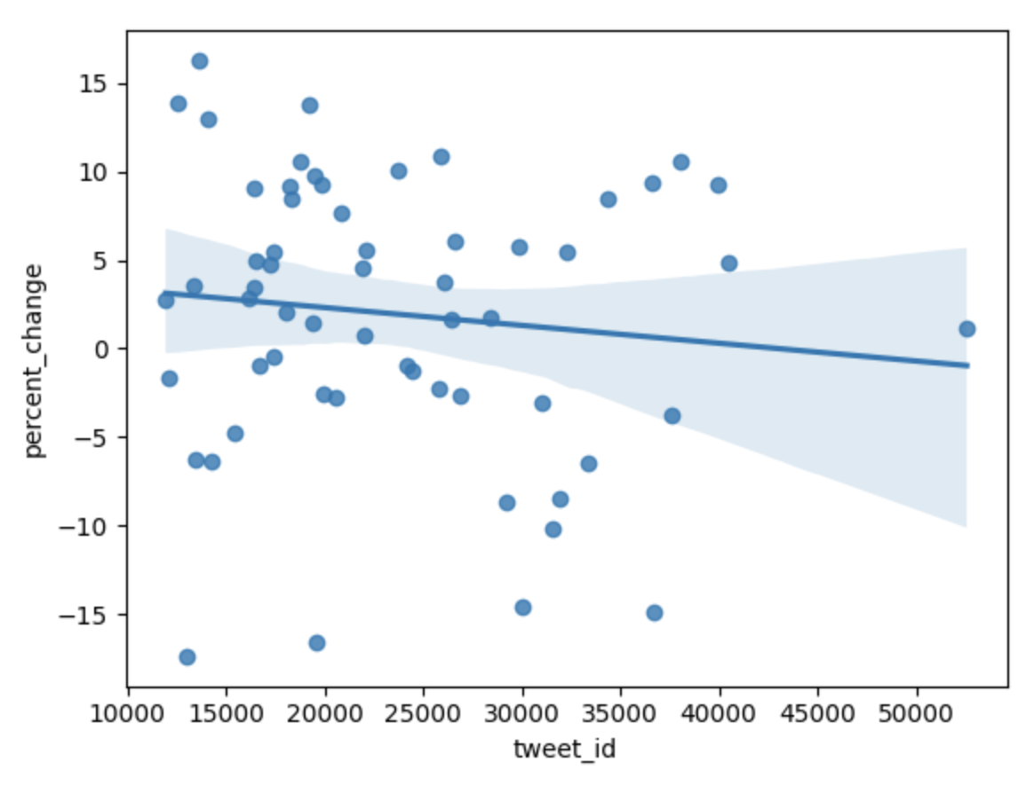
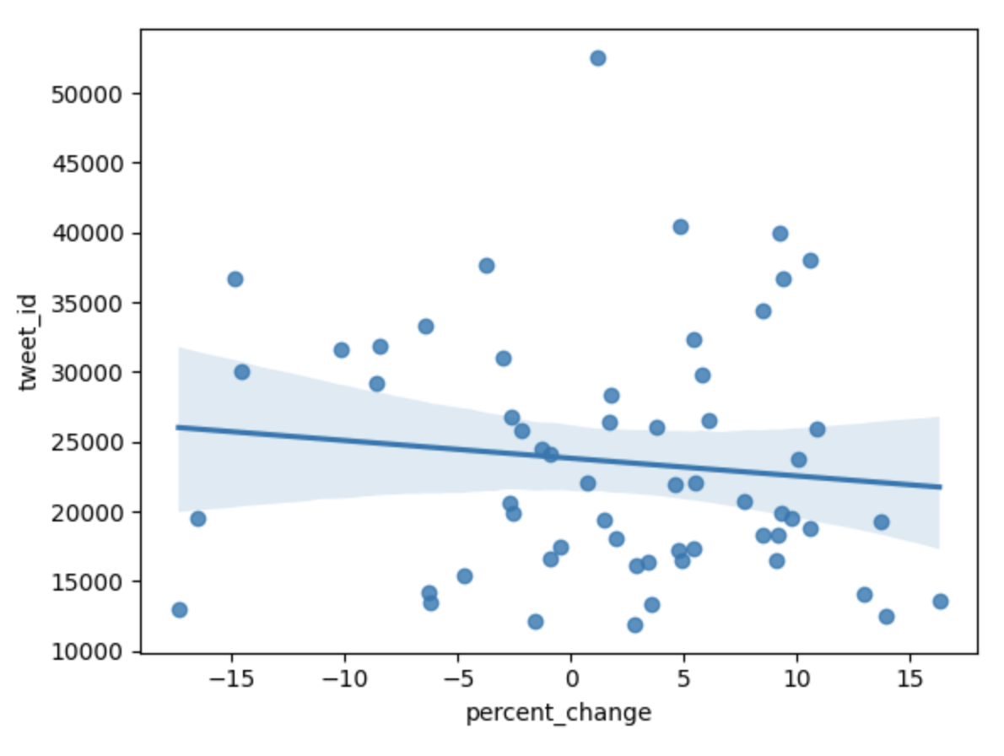
Regression Plots

Slide 18
Bootstrap Test
Null Hypothesis: The slope of the regression line is equal to 0.
Perform regressions on the bootstrapped data
1000 simulation
Calculate the p-value

Slide 19
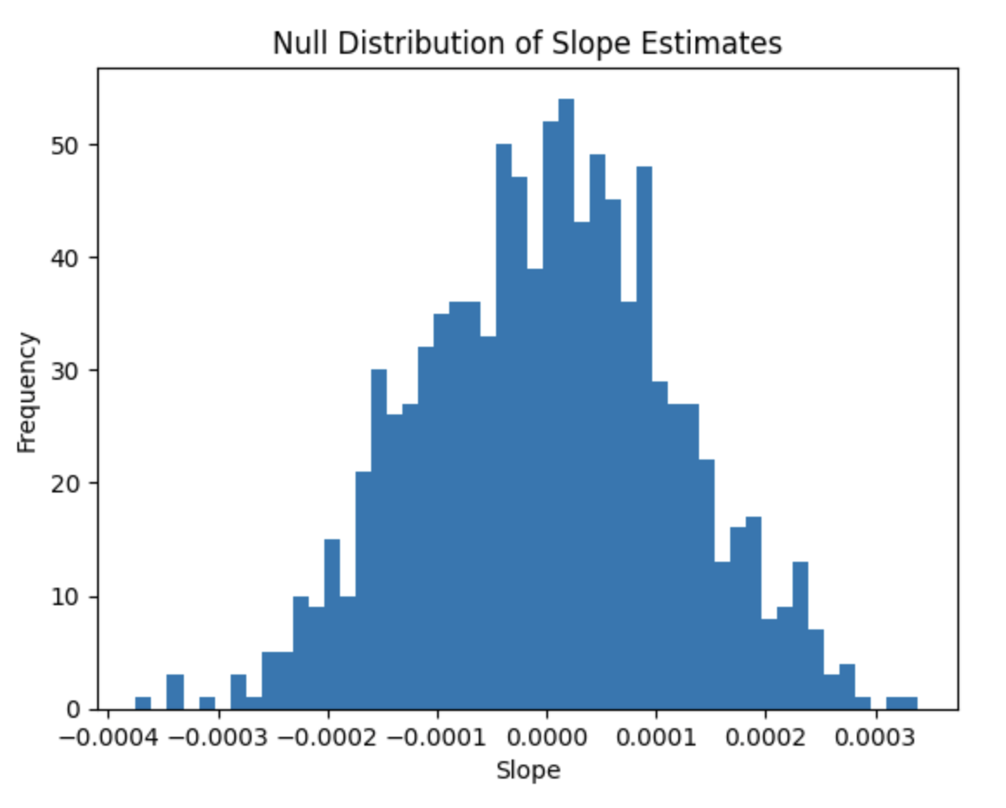
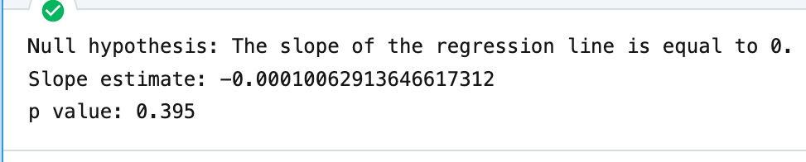
Bootstrap Visualization

Slide 20
Further Steps

Slide 21
Further Steps
Using a prediction model - although the results turned out to be relatively inconclusive, it would be interesting to generate a Machine Learning based prediction model to estimate the amount of percent change that correlates to the amount of tweets and vice-versa.

Slide 22
Further Steps
Using a prediction model - although the results turned out to be relatively inconclusive, it would be interesting to generate a Machine Learning based prediction model to estimate the amount of percent change that correlates to the amount of tweets and vice-versa.
Expanded dataset - the tweets and stock ticker/valuation only dated back to 2015, and only used monthly data - conclusions drawn from a wider ranging dataset that maybe used daily values and insights could be more comprehensive.

Slide 23
Thank you.

